Slide 1
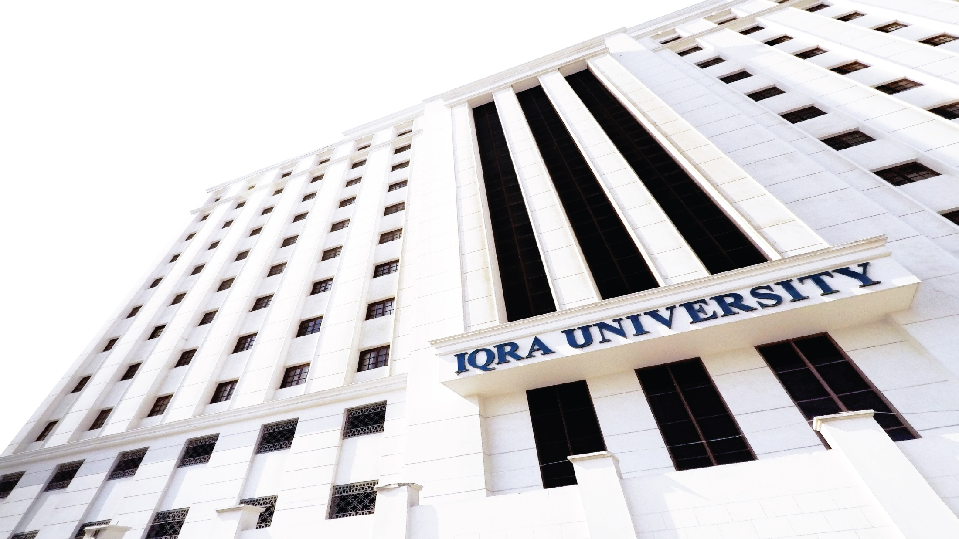

Stress, Types and Responses
Prepared by Dr. Rabia Mushtaq

Slide 2
Key Points
01
Know the meaning of stress
02
Types of stress
03
Stress Responses/Symptoms

Slide 3

What is Stress?
Stress can be defined as our mental, physical, emotional, and behavioral reactions to any
perceived demands or threats.

Slide 4
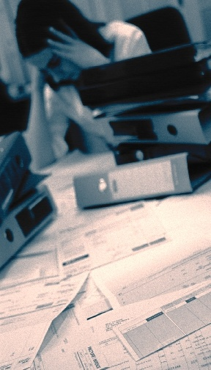
Why Do We "Stress Out"?
For two major reasons:
We perceive a situation as threatening, difficult, or painful.
We don't believe we have the resources to cope.

Slide 5
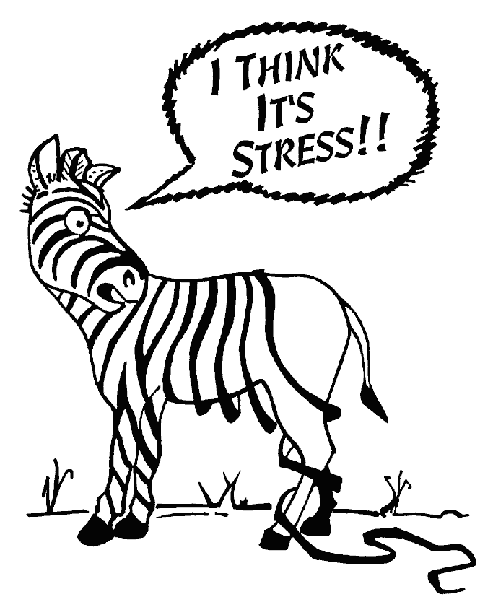

Slide 6
Controllability of an event
The degree to which we can make event happen or stop it from
happening.
The lesser the individual feel control over event , more stressful event is perceived by that individual.
Individual perception of his/her ability to control plays vital role.

Slide 7
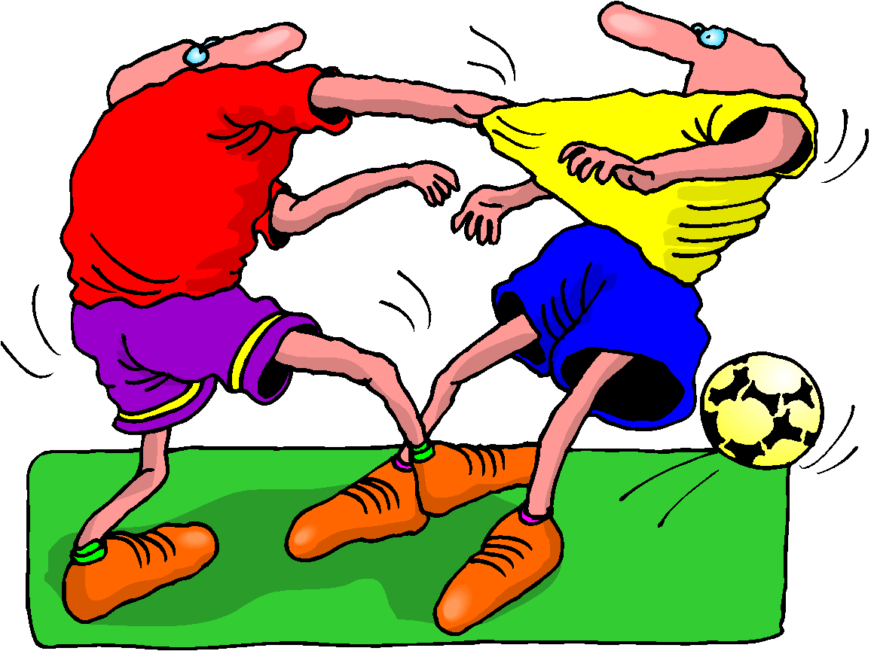
The “Fight or Flight” Response
When situations seem threatening to us, our bodies react quickly to supply protection by preparing to take action. This physiological
reaction is known as the "fight or flight"
response.
The physiological response to a stressor is known as
reactivity
Physiological responses can accumulate and result in
long-term wear on the body

Slide 8
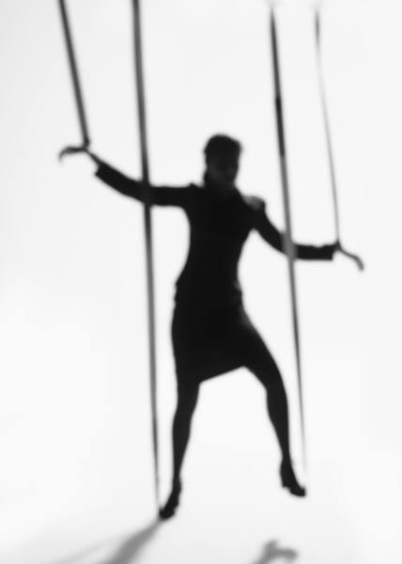
What Makes Something Stressful?
Situations that have strong demands
Situations that are forthcoming
Life transitions
Ambiguity
Desirability
Controllability

Slide 9
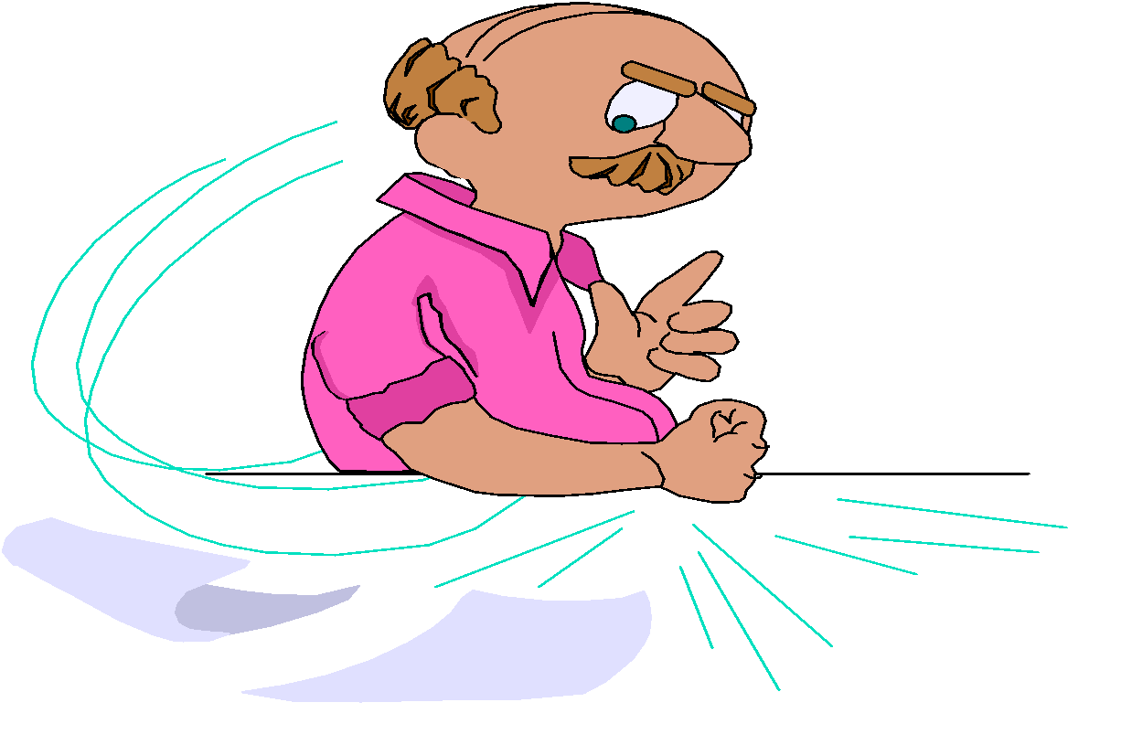
STRESS FEELINGS
Worry
Tense
Tired
Frightened
Elated / Excited
Depressed
Anxious
Anger

Slide 10
TYPES OF STRESS
EUSTRESS: Stress that is deemed healthful or giving one the feeling of fulfillment
DISTRESS: Stress that causes pain, suffering, trouble, danger, etc.

Slide 11
Not All Stress is Bad…
Eustress is a form of stress that is positive and beneficial.
We may feel challenged, but the sources of the stress are opportunities that are
meaningful to us.
Eustress helps provide us with energy and motivation to meet our responsibilities and achieve our goals.
graduating from college,
getting married,
becoming a parent,
receiving a promotion or changing jobs.

Slide 12
Distress is a continuous experience of feeling overwhelmed, troubled, and behind
in our responsibilities.
It is the all encompassing sense of being imposed upon by difficulties with no light at the end of the tunnel.
financial difficulties,
conflicts in relationships,
excessive obligations,
managing a chronic illness, or
experiencing a trauma.

Slide 13
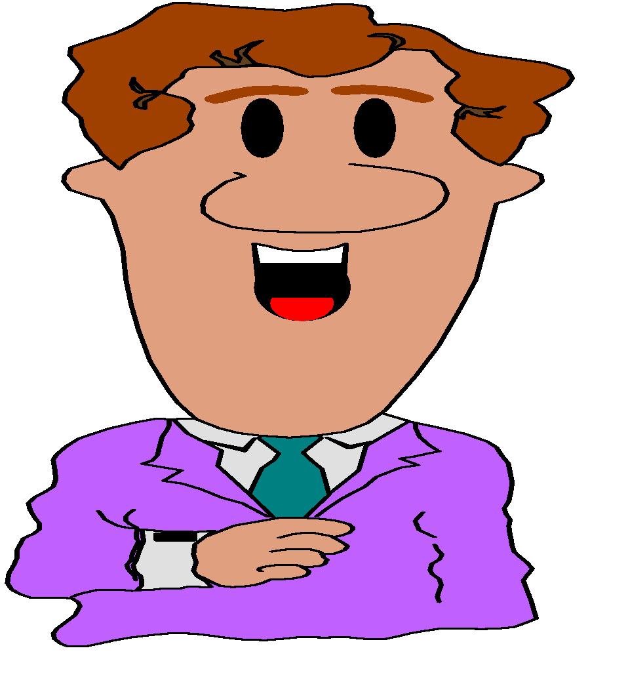
Stress Responses
Physical Response
Mental Response
Behavioural Response
Emotional Response

Slide 14
Physical Responses
Racing heart,
Clammy or sweaty hands,
Body shaking,
Rapid and shallow breathing,
Jaws tightening,
Light-headedness
Body aches
Low energy

Slide 15
Behavioral Responses
Stuttering,
look down, or avoidance of eye contact
Avoidance of meeting with people
Excessive TV / Gaming
Overeating / less eating
Sleep disturbance
Grinding teeth
Nail biting
Smoking / drugs

Slide 16
Cognitive Responses
Mind going blank,
Racing thoughts
Thoughts about making a mistake,
Looking ridiculous in front of peers
Indecisiveness
Poor concentration
Confusion
Memory failure

Slide 17
Emotional Responses
Anxious,
Fearful
Anger/ frustration
Depression
Crying spells
Guilt
Helplessness
Hopelessness
Suicide

Slide 18
Thank You

